Slide 1
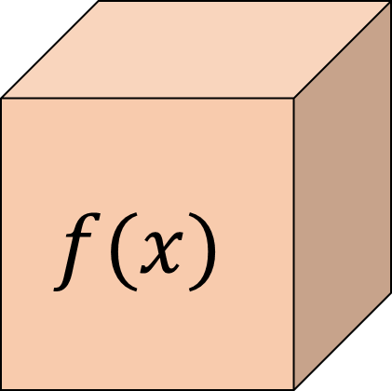
数字を１つ入れると、数字が１つ出てくる箱
があります。
$$f(x)$$
1
3
関数

Slide 2
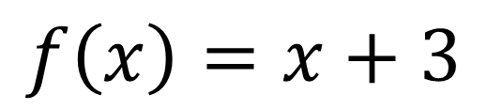
$$f\left(x\right)=x+3$$
$$f(x)$$
1
4

Slide 3
$$f\left(x\right)=x+3$$
$$f(x)$$
2
5

Slide 4
$$f\left(x\right)=x+3$$
$$f(x)$$
3
6

Slide 5
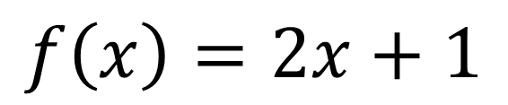
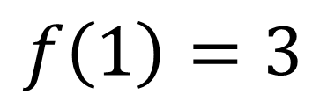
$$f\left(x\right)=2x+1$$
$$f(x)$$
1
3
$$f\left(1\right)=3$$

Slide 6
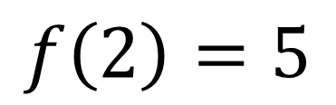
$$f\left(x\right)=2x+1$$
$$f(x)$$
2
5
$$f\left(2\right)=5$$

Slide 7
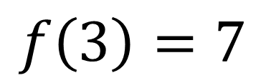
$$f\left(x\right)=2x+1$$
$$f(x)$$
3
7
$$f\left(3\right)=7$$

Slide 8
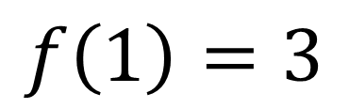
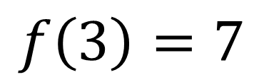
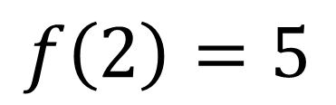
グラフの描き方
$$f\left(1\right)=3$$
7
5
$$f\left(2\right)=5$$
3
$$f\left(3\right)=7$$
1
2
3

Slide 9
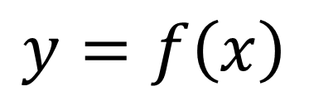
$$y=f\left(x\right)$$
グラフの描き方
$$f\left(1\right)=3$$
7
5
$$f\left(2\right)=5$$
3
$$f\left(3\right)=7$$
1
2
3

Slide 10
$$y=f\left(x\right)$$
グラフの描き方
$$f\left(1\right)=3$$
7
5
$$f\left(2\right)=5$$
3
$$f\left(3\right)=7$$
1
2
3

